Slide 1
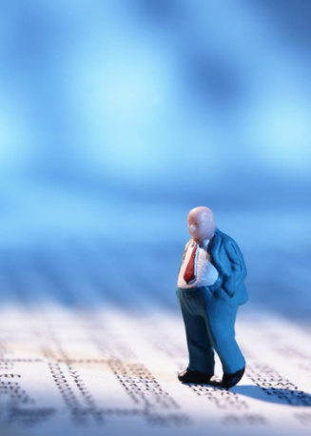

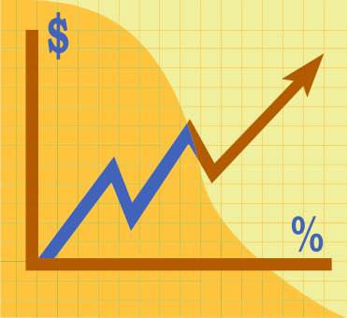
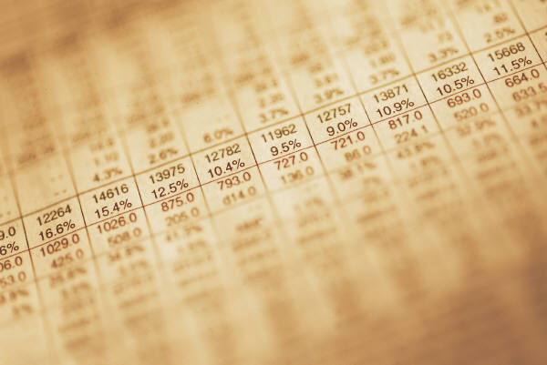
The Stock Market
What Is It?

Slide 2


Introduction
Why do people start businesses?

Slide 3
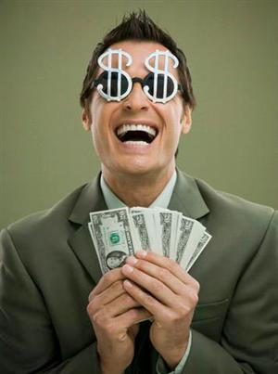
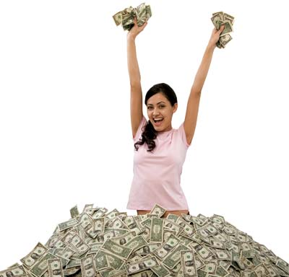
Profit
When you make money in business, it is called a profit.
Mathematically: Profit = Revenue – Cost
For example: If you buy an iPod for $250 and sell it for $300, you made a profit of …

Slide 4
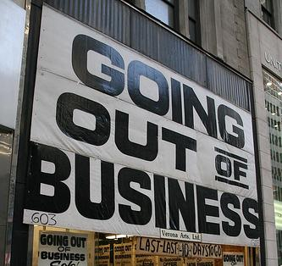
Loss
There is also a risk that you will lose money!

Slide 5
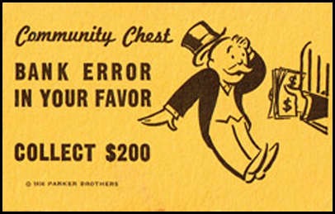
How do you raise money to start a new business?
One way to raise money is to borrow money from a bank. This money must be paid back.

Slide 6
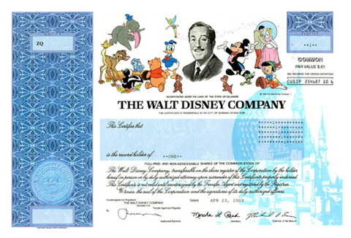
Stocks
You can also sell ownership in the company. This means you have other people give you money and they have a share in the profits (and losses) of the company. These ownership shares are called shares of stocks.

Slide 7
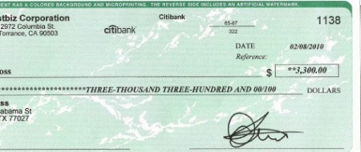
Dividends
When a company makes a profit, they typically pay the owners of stock a dividend.

Slide 8
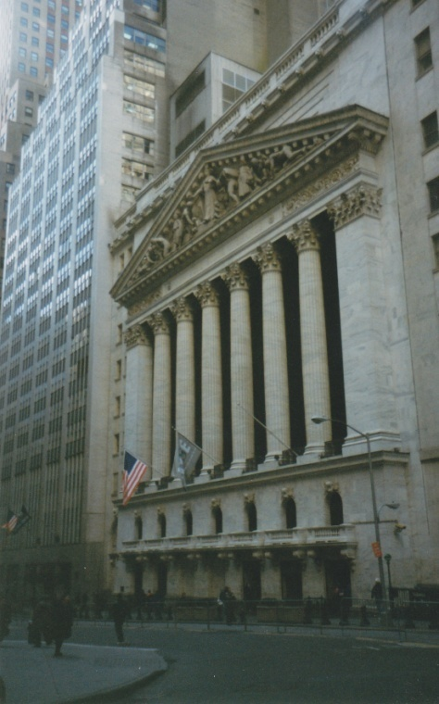
The Stock Market
If you own shares of a company, you can sell them to other people in the stock market.
The New York Stock Exchange (NYSE) is one of these markets.

Slide 9
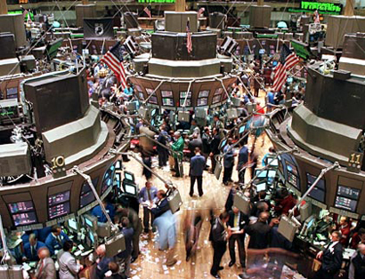
Stock Prices
When a company is doing well, more people want to buy the stock and its price in the market rises.
When a company is not doing well, more people want to sell the stock and its price falls.

